Slide 1



Declining Customer Engagement and Conversion: Root Causes & Growth Opportunities
May
20
25
Performance Analysis, Root Causes & Strategic Recommendations

Slide 2
Executive Summary
Key Takeaways
Root Causes
Recommended Actions
Declining traffic volume
High-traffic products not converting
Falling content engagement
Customer experience concerns
Optimize low-converting high-traffic products
Improve checkout journey
Revamp content strategy
Address customer dissatisfaction
Conversion rate declined from 11.58% (2023) to 8.55% (2025).
Website traffic dropped from approximately 5,000,203 views to 1,096,704 views.
Significant customer drop-off occurs after clicks.
Customer ratings remain moderate at 3.69/5.

Slide 3
Business Impact
The Core Challenge
Traffic and Conversion Are Declining Simultaneously
Multi-Year Trend Metric Matrix
Key Strategic Insight
Year | Total Views | Conversion Rate | Annual Trend
2023 | 5,000,203 | 11.58% | High Baseline
2024 | 2,982,369 | 8.48% | -26.7% Drop
2025 | 1,096,704 | 8.55% | Volume Collapse
Total | 9,079,276 | 9.57% | Average Overall
The business is suffering from a double compounding friction: we are attracting 78% fewer total visitors while simultaneously converting a 26% smaller fraction of those visitors into paid buyers.
Imperative: Fix post-click landing page friction while stabilizing top-of-funnel reach.
Key insight:
The business is attracting fewer visitors and converting a smaller percentage of those visitors into buyers.

Slide 4
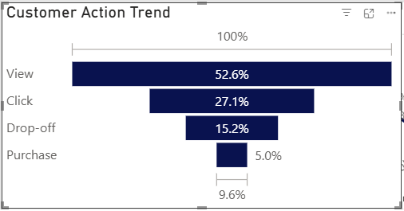
Customer Funnel
Where Are We Losing Customers?
Largest Revenue Leakage Occurs Between Click and Purchase
Key insight:
Content successfully generates awareness and clicks.
The biggest opportunity is improving conversion after the click.

Slide 5
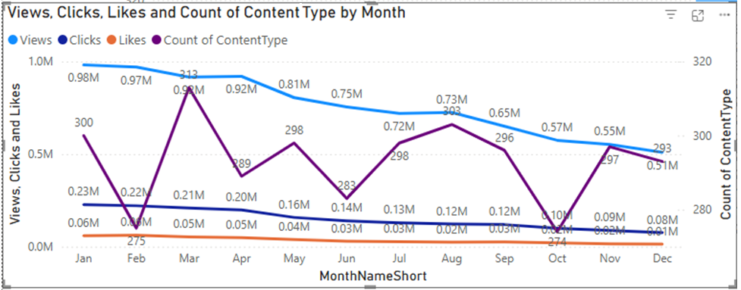
Traffic vs Content Volume
Content Volume Is Stable, But Reach Is Falling
Business Interpretation
The issue is not publishing frequency. Approximately 294 content pieces uploaded monthly
The issue is content effectiveness.

Slide 6
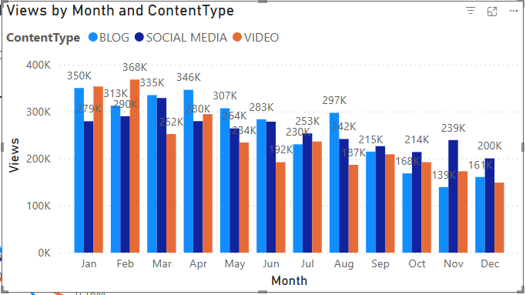
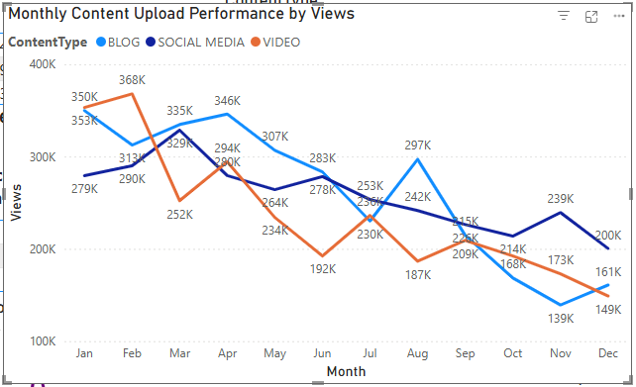
Content Performance
Blogs and Videos Consistently Outperform Social Media
High Performers
Blog content
Video content
Underperformer
Social media content
Action
Reallocate content resources toward formats that consistently generate engagement.

Slide 7
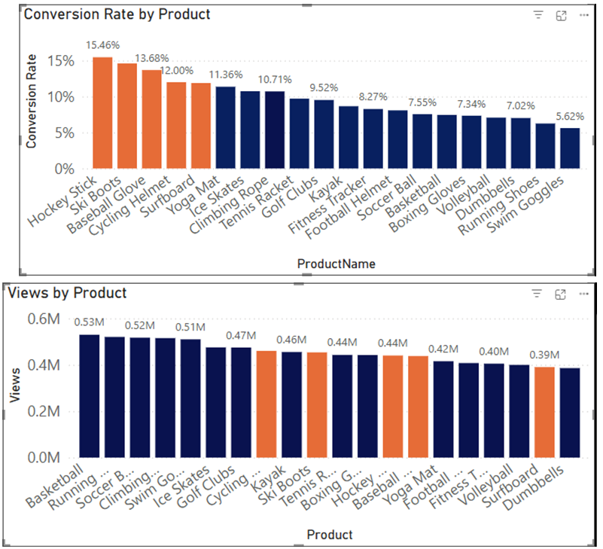
Product Performance
Marketing Attention Is Focused on the Wrong Products
High-visibility products are not the highest converters.
High Views + Low Conversion
Basketball
Running Shoes
Soccer
High-converting products receive less traffic than lower-converting products.
Lower Views + High Conversion
Hockey Stick
Ski Boots
Baseball Glove
Opportunity
Increase exposure of proven high-converting products.

Slide 8
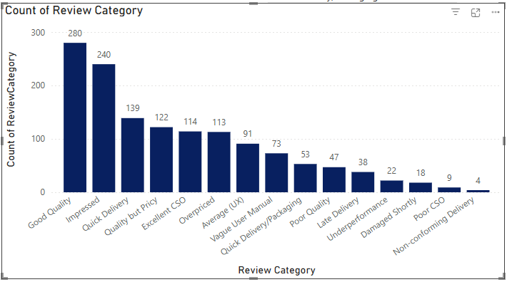
Customer Feedback Insights
Customer Reviews Reveal Key Purchase Barriers
Ratings and reviews identify pricing, delivery and quality concerns.
Positive Feedback
Product quality
Quick delivery
Good customer service
Negative Feedback
Pricing concerns
Poor quality concerns
Delivery issues
Customer service issues
Product performance issues
Customer Reviews By Perception of Product
Insight
Customer experience is limiting conversion growth

Slide 9
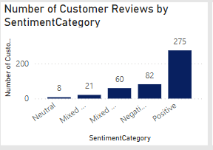
Root Cause Analysis
Traffic, content, product alignment and customer experience drive conversion decline.
Why Conversion Is Falling
Traffic Problem
Overall reach is declining
Content Problem
Social media engagement weakening
Product Problem
Traffic concentrated on lower-converting products
Customer Experience Problem
Ratings below desired benchmark
Negative and mixed reviews remain significant
Customer Reviews By Sentiment Category

Slide 10
Priority Recommendations to Reverse Conversion Decline
Priority 1
Priority 2
Priority 3
Priority 4
Optimize Top Products
Reduce Funnel Drop-off
Content Optimization
CX Improvements
Improve landing pages
Strengthen Calls-to-Action (CTAs)
Improve product descriptions
Improve checkout experience
Review pricing transparency
Improve page speed
Increase use of blogs and videos
Reduce ineffective content formats
A/B test creatives
.
Address negative reviews
Improve support processes
Improve delivery experience
Loyalty Program
Priority
Short Term Action
Medium Term Action
Long Term Action
Management should prioritize product-page optimization, checkout improvements, content strategy and customer experience.

Slide 11
Expected Business Outcomes
Success Metrics
Track/Monitor:
Business objective | KPI
Recover website traffic | Monthly website views
Improve conversion | Conversion rate
Improve product engagement | Product page CTR
Reduce lost sales | Checkout abandonment rate
Improve customer experience | Average rating
Increase customer retention | Repeat purchase rate

Slide 12
Conclusion
Final Takeaway
The decline in conversion is driven by four interconnected issues:
Reduced traffic
Weakening engagement
Product-content misalignment
Customer experience challenges
Addressing the four root causes should improve engagement and conversion performance.

Slide 13
CONCLUSION
Addressing the 4 Interconnected Root Causes Will Drive Sustainable Growth
By aligning ad spend with high-converting products, optimizing video/blog formats, and fixing post-click landing page friction, Shop.Com can restore revenue momentum.
Contact: davoazorji1@gmail.com
Shop.Com Performance & Strategy Presentation

